Slide 1
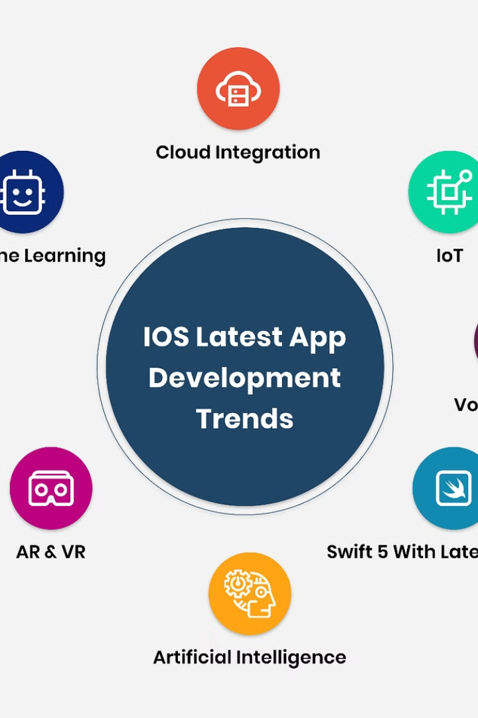
Mobile App Development: Types, Languages, and Frameworks
Welcome to our comprehensive presentation on mobile app development. We'll explore the major types of mobile applications, compare programming languages, evaluate development frameworks, examine architecture patterns, discuss requirement engineering, and analyze cost estimation strategies.
This presentation is designed to provide you with a thorough understanding of the mobile development landscape, helping you make informed decisions for your next project. Let's begin our journey through the world of mobile app development.

Slide 2
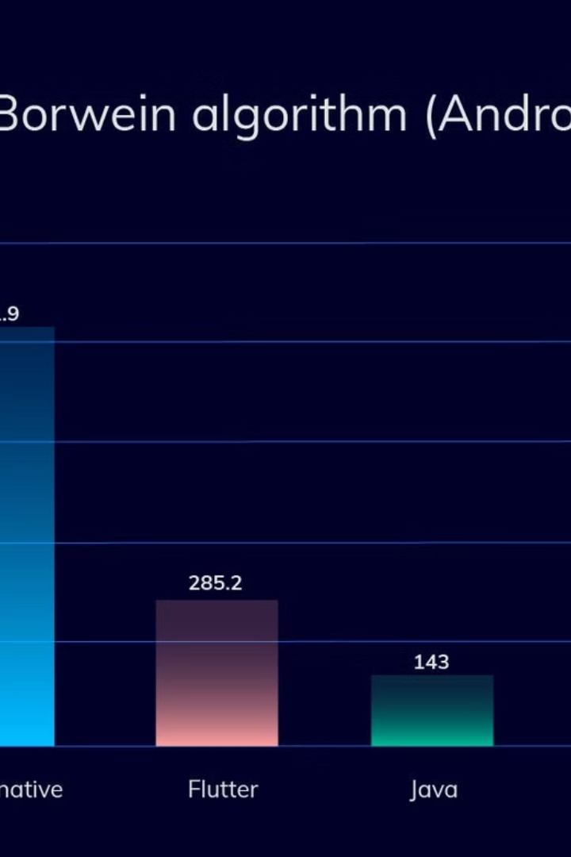

Comparing Mobile App Types
Native Apps
Progressive Web Apps (PWAs)
Built specifically for one platform (iOS/Android) using platform-specific languages. Offers high performance, full hardware access, and excellent UX. Requires separate development for each platform, increasing costs and maintenance complexity.
Web applications that provide app-like experiences in browsers. Cross-platform compatible with a single codebase, lower development costs, and no app store approval needed. Limited hardware access and performance compared to native apps.
Hybrid Apps
Combine web technologies wrapped in native containers. Faster development with one codebase, lower costs, and access to some native features. Performance issues and UI/UX inconsistencies compared to native apps.
by Shalom nda

Slide 3





Mobile App Programming Languages
iOS Native: Swift
Modern language optimized for Apple devices with high performance and security. Limited to Apple ecosystem with a smaller talent pool.
Android Native: Kotlin/Java
Kotlin is modern and concise with official Google support. Java offers strong legacy support but is more verbose. Both are Android-specific.
Cross-Platform: Flutter (Dart), React Native (JavaScript)
Flutter offers native-like performance with rich UI. React Native has a large ecosystem with reusable components. Both enable development for multiple platforms.
Web-Based: HTML/CSS/JavaScript
Works on any device with a browser. Limited access to device features and lower performance than native solutions.

Slide 4
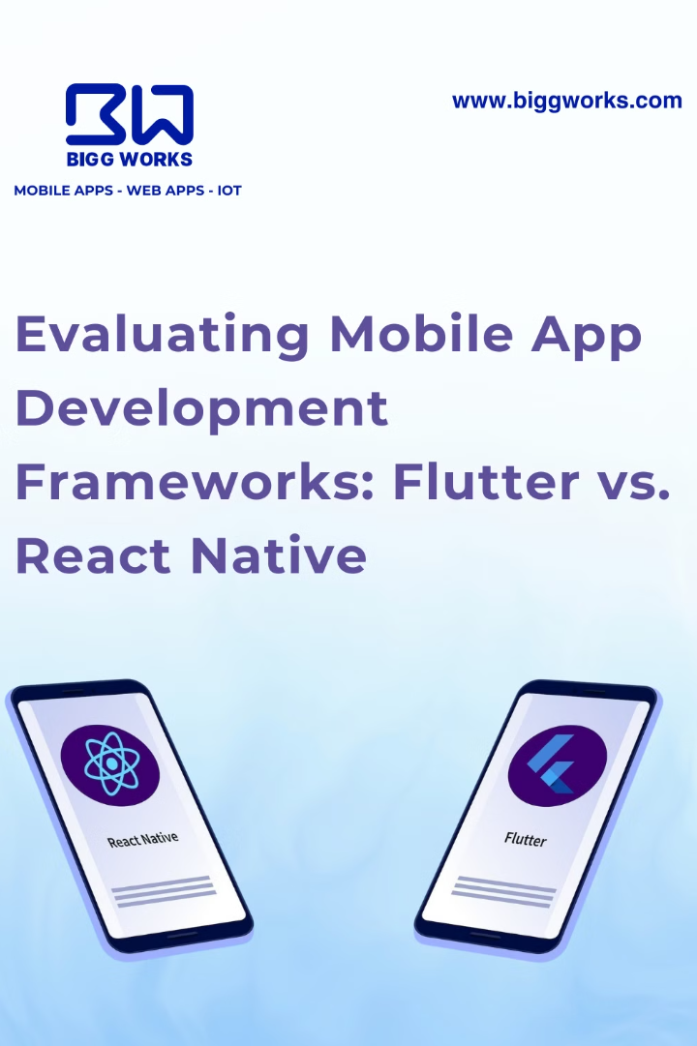
Mobile App Development Frameworks
Framework
Language
Performance
Cost & Time
UI/UX
React Native
JavaScript
High
Fast
Native-like
Flutter
Dart
Very high
Fast
Rich UI
Xamarin
C#/.NET
High
Moderate
Native-like
SwiftUI/Jetpack
Swift/Kotlin
Very high
Slow
Native
Ionic
HTML/CSS/JS
Moderate
Very fast
Web-like

Slide 5
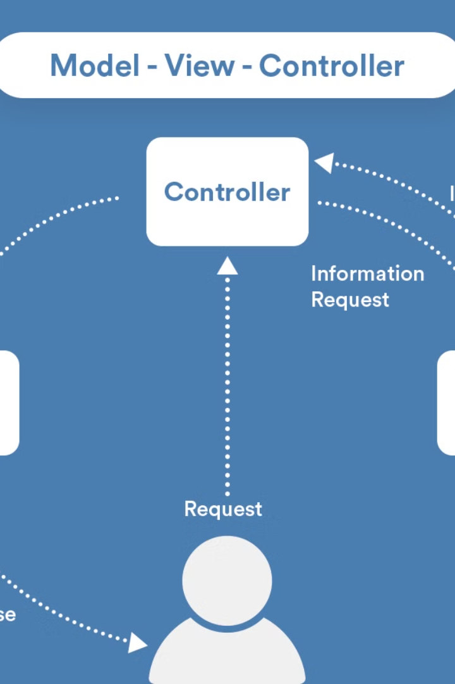




Mobile App Architectures
MVC
Model-View-Controller separates data, UI, and logic. Simple but can lead to massive controllers.
MVP
Model-View-Presenter puts more responsibility on the presenter for managing interactions.
MVVM
Model-View-ViewModel uses data binding to connect the view and viewmodel, reducing code complexity.
VIPER
View-Interactor-Presenter-Entity-Router separates concerns into distinct layers for complex apps.

Slide 6










Mobile App Design Patterns
Factory Method
Singleton
Defines interface for creating objects but lets subclasses decide which class to instantiate.
Ensures only one instance of a class exists, useful for managing shared resources.
Observer
Defines one-to-many dependencies so when one object changes state, dependents are notified.
Strategy
Defines family of algorithms, encapsulates each one, making them interchangeable.
Adapter
Allows incompatible interfaces to work together by wrapping an object.

Slide 7
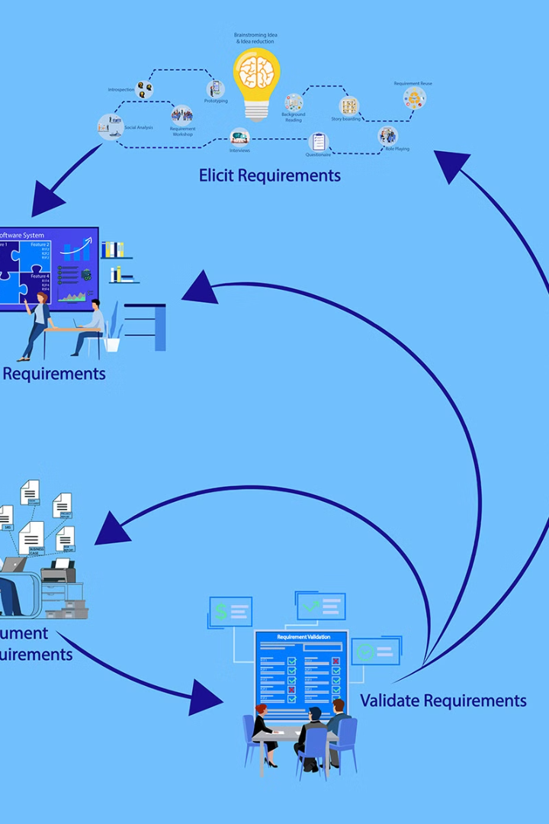
Requirement Engineering for Mobile Apps
Requirement Elicitation
Gather information from users and stakeholders through interviews, surveys, focus groups, observation, and user stories.
Requirement Analysis
Examine and refine collected requirements, categorizing them into functional, non-functional, and domain-specific needs.
Requirement Specification
Document requirements formally using tools like JIRA, Trello, Confluence, and Lucidchart for clear visualization.
Requirement Validation
Ensure requirements meet stakeholder needs through validation and verification processes, addressing challenges like ambiguity and changing requirements.

Slide 8
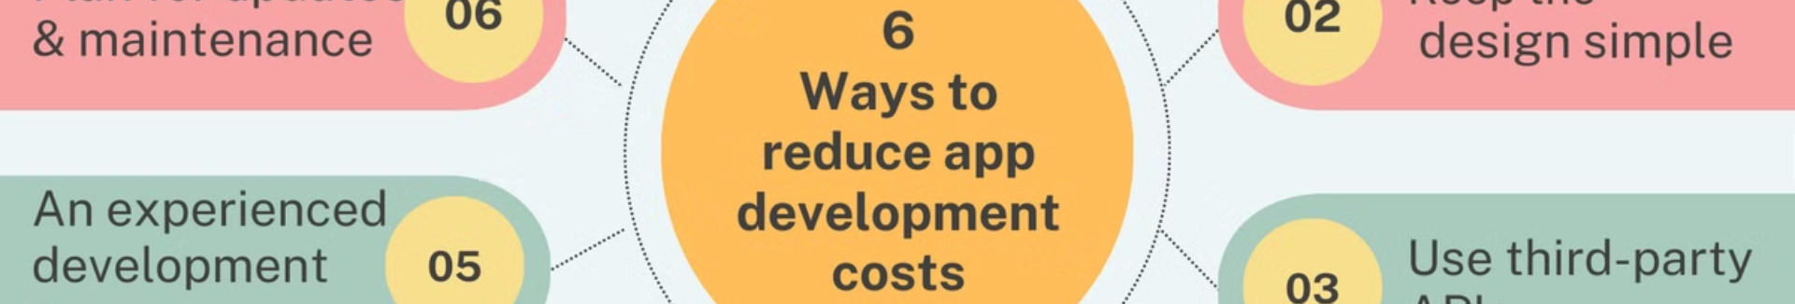




Mobile App Development Cost Factors
Scope and Features
Platform Selection
Authentication, notifications, API integrations, payment gateways, geolocation, messaging, admin dashboards, and AI/ML features all increase development costs.
Native development for iOS/Android is more expensive than cross-platform solutions. Web apps are cheaper but may lack native functionality.
UI/UX Complexity
Development Team
Simple UI with basic screens, medium UI with custom designs, or complex UI with advanced animations significantly impact costs.
Costs vary by team composition: freelancers (30,000-150,000 frs/month), small agencies (100,000-250,000 frs/month), or enterprise agencies (300,000+ frs/month).

Slide 9
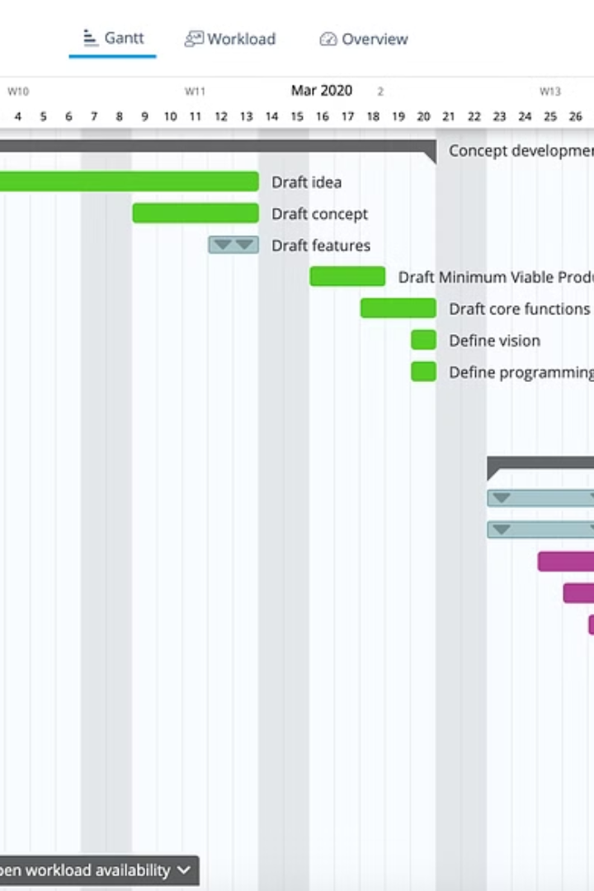
Mobile App Development Cost Breakdown
500-800
800-1500
Basic App Hours
Medium App Hours
Development hours for simple applications with limited features
Development hours for moderately complex applications
1500+
Complex App Hours
Development hours for feature-rich, complex applications
Beyond initial development, budget for backend development, maintenance (15-20% of initial cost annually), and marketing expenses. Total costs range from 70,000 frs for basic apps to over 100,000,000 frs for complex enterprise solutions.
Proper planning and clear project scope are essential for accurate cost estimation. Remember to account for post-launch updates and marketing to ensure long-term success.

